Slide 1
Popularity Prediction in Spotify Dataset using Ensemble Learning
SUBMITTED BY:
Anil Dhakal (C0898886)
Nishant Neupane (C0899757)
Raju Pandit (C0893347)
Sanat Kumar Upreti (C0898884)
Sujan Lamichhane (C0898959)

Slide 2
Agenda Overview
Project Introduction
Dataset Overview
Data Extraction
Exploratory Data Analysis
Data Preprocessing
Model Analysis
Data Visualizations
K-Fold Cross Validation
Hyper-parameter Tunning
Useful Applications

Slide 3

Project Introduction
Overview: To predict the popularity level of songs based on diverse set of input features
Motivation: Song popularity prediction has significant importance in music industry
Why Spotify?: largest and popular music streaming platform, provide diverse range of data

Slide 4
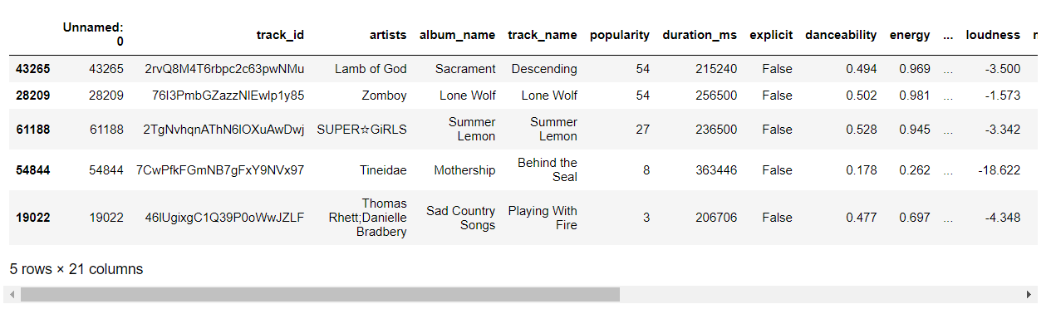
Dataset Overview
Structed format i.e. CSV file (Spotify Tracks Dataset)
Taking 0.33 (~38K) fraction of whole dataset as the dataset is too big (110K+ observations).
Total features in original dataset – 21 features (target - popularity)
Data types – Object(like ‘str’), Bool, Integer, and Float

Slide 5
Data Extraction
Source of Dataset – Kaggle (public dataset)
Tools used for extraction – Pandas
Using read_csv() method for reading CSV file
Using sample(frac=0.33) method to perform random sampling
Extracted and loaded as DataFrame object (rows X columns = table)

Slide 6
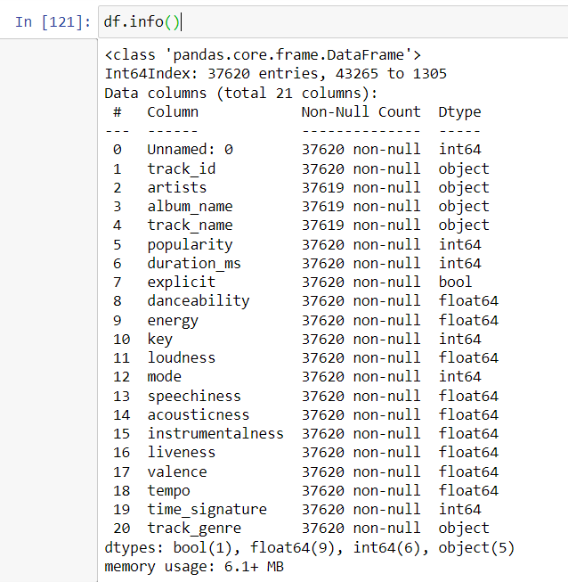
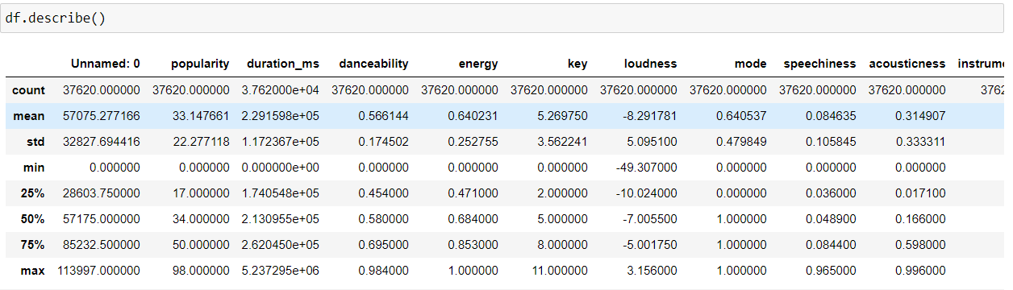
Exploratory Data Analysis (EDA)
df.info()
df.describe()

Slide 7
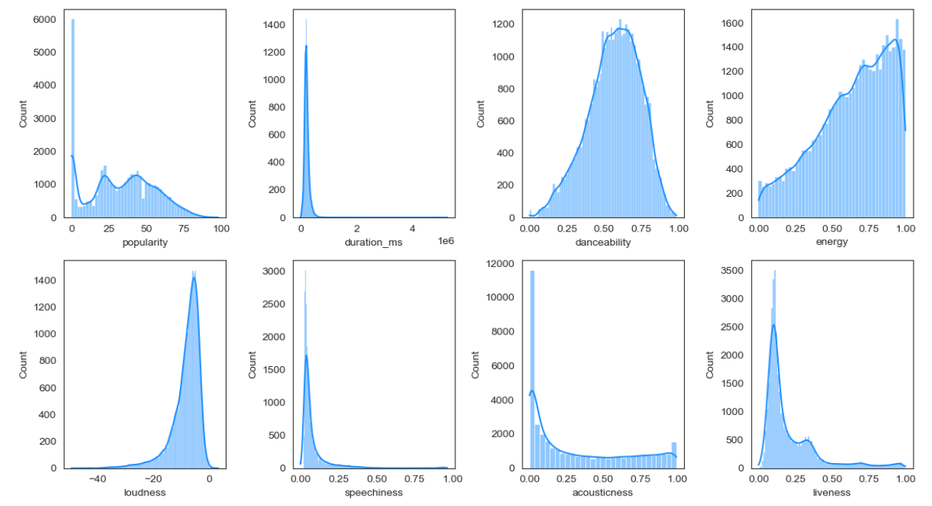
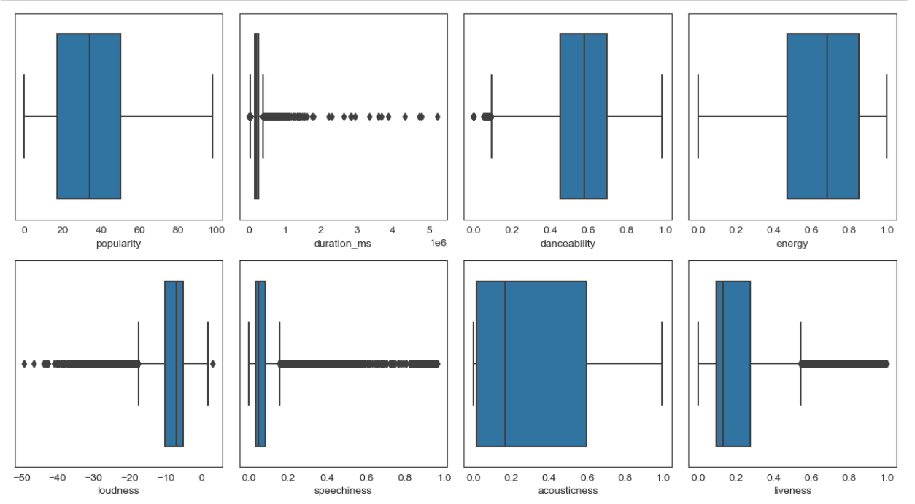
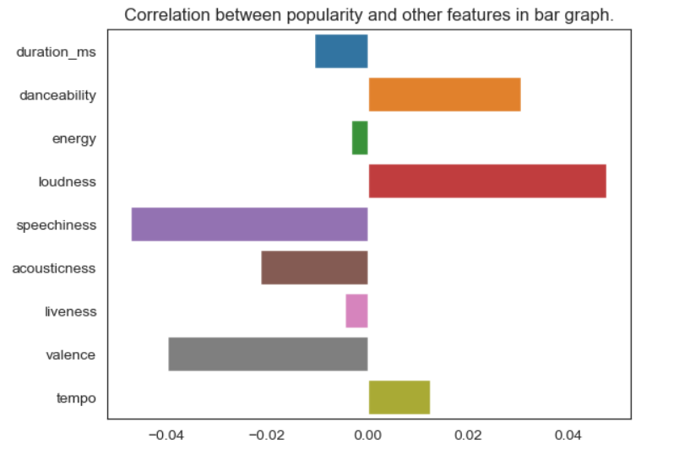

Slide 8
Data VALIDATION AND CLEANSING
Data Validation and Cleansing
- Checking null values and counting it. → df.isna().sum()
- The track_id, album_name and track_name features had one-one null value.
- Just dropping the null valued observations. → df.dropna()
- Checking duplicated values and counting it. → df.duplicated().sum()
- Found 62 duplicated values after removing unique column “Unnamed: 0”
- Just dropping the duplicated observations → df.drop_duplicates()
Feature Scaling
- “duration_ms” → denotes the total duration for which song was streamed.
- Initially it was in milliseconds and values were large. So, need to scale down
- df['duration_ms'] = df['duration_ms'] / (1000).
- Then, renamed this as “duration_s” i.e. s for seconds.

Slide 9
Data Aggregation and Representation
- top five artists, track_genre, and time-signature based on popularity
Label Encoding and One-Hot Encoding
- “explicit” feature has binary values i.e. True or False. → Label Encoded
- “track_genre” feature has 114 classes i.e. categorical values → One Hot Encoded

Slide 10
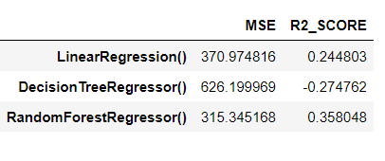
Model Analysis
X = df.drop(['popularity'], axis=1), y = df['popularity’]
Used train_test_split() from sklearn, test_size=0.45
Models Used for Initial Analysis:
- LinearRegression, DecisionTreeRegressor, and RandomForestRegressor
This accuracy is for 0.33 fraction of data. Increase to 45-50% when full dataset is used.

Slide 11
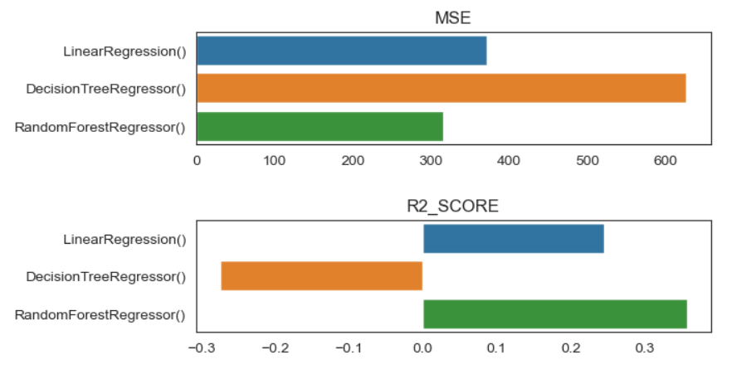
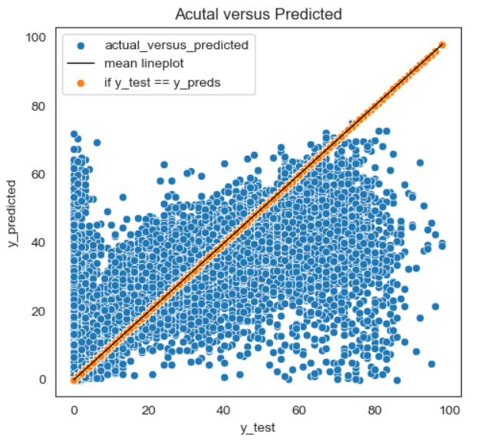
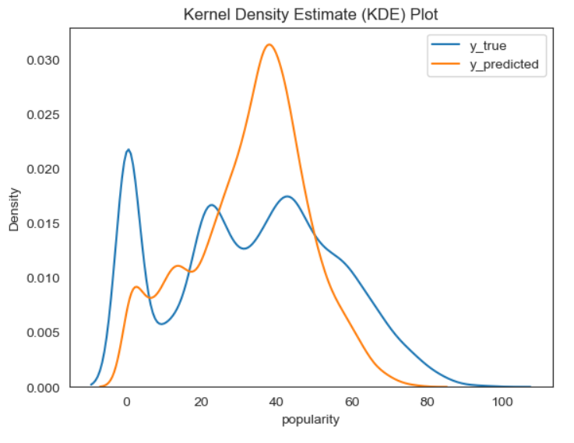
Data Visualization

Slide 12
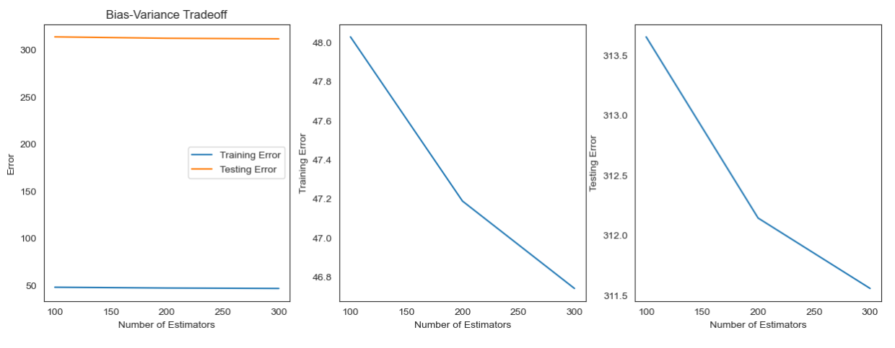
Data Visualization

Slide 13
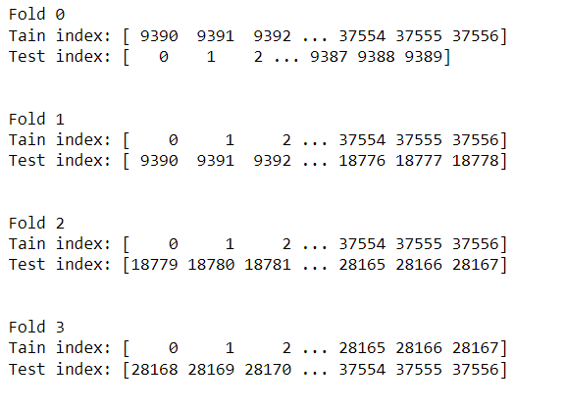
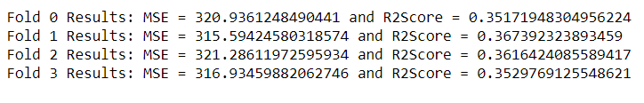
K-fold Cross Validation
K-fold Datasets e.g. k = 4
Using RandomForestRegressor
3 folds are used for training and one fold for validation
For each fold, mse and r2_score are calculated.
Fold 1 has highest r2_score. It is suitable fold.

Slide 14
K-fold Cross Validation
Training the model with appropriate i.e. Fold 1
Then, testing model on unseen data namely X_hold, y_hold
Using the appropriate fold of dataset, R2 score increased significantly as shown above.

Slide 15
Hyper-Parameter Tuning
Through Cross-Validation using GridSearch from Scratch
- n_estimators = [200, 300], max_depth = [None, 10],
criterion = ['squared_error’]
- scores = cross_val_score(model, X, y, cv=3,)
- np.mean(scores)
From above hyperparameter list, choose the optimal parameter as one with highest scoring.
In this way, the hyper parameter can be tuned

Slide 16
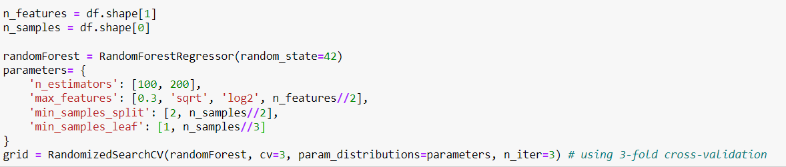
Hyper-Parameter Tunning: RandomizedSearchCV
This algorithm forms the combination of hyperparameters but select the combination of parameters randomly.
Iterate until stopping conditions like number of iterations or desired output accuracy is achieved

Slide 17
Useful Applications of the Project
Personalized Playlist formation
Marketing Campaign – using popular songs in social media content, games, commercial advertisement, etc.
Music Trend Analysis
Music Recommendation System

Slide 18
The End. Thank You!
Any Questions ?

